Slide 1
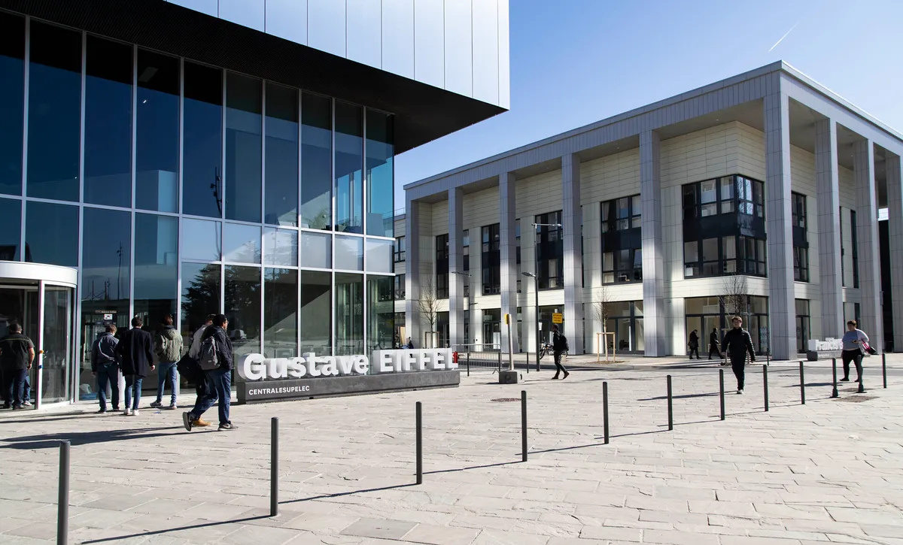

Industrial Panel
July 2, 13:30
Auditorium Michelin, Eiffel building, CentraleSupélec
Joint IFAC conference SSSC, TDS & COSY
JUNE 30 AND JULY 2ND, 2025
CentraleSupélec, Gif-sur-Yvette, France
Industrial Panel Executive Director and Chair: Riccardo Bonalli
Invited Experts: Guillame Avrin (French National AI Coordinator), Guilhem Boeris (Wandercraft Robotics), and Giovanna Martinez Arellano (University of Nottingham)

